Slide 1

Software Engineering
CS-303
Work Breakdown Structure (WBS)
Lecture # 12,13
18 Feb
Slides by:
Rubab Jaffar

Slide 2
SW
Project
SCOPE
Deployment
Planning
UAT
Operation
Requirements
Maintenance
Design
Development
Testing
Built
Release

Slide 3
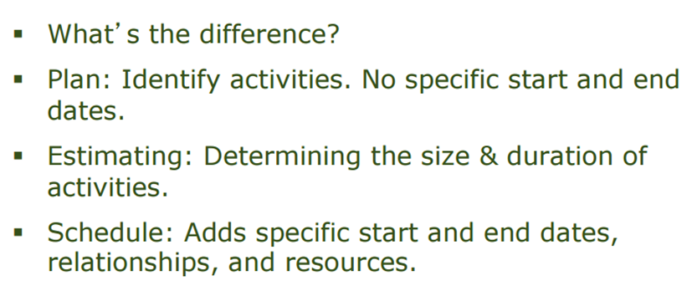
Project Management

Slide 4
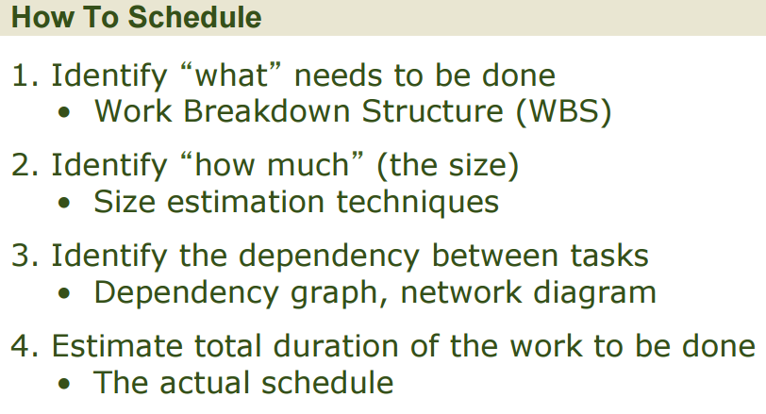
Why is it needed?

Slide 5
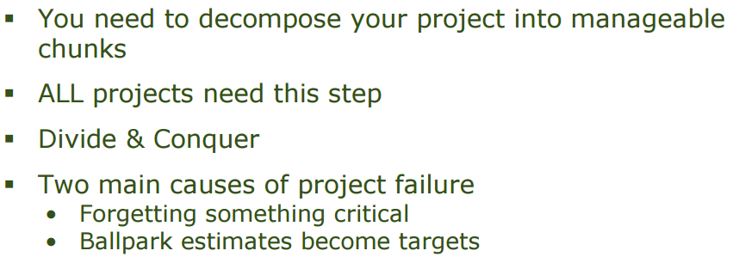
Why (cont…)
Notes:
A ballpark figure is a rough numerical estimate or approximation. Ballpark figures are commonly used by accountants, salespersons and other professionals toestimate current or future results

Slide 6
Project Management Processes (Initiation)
Project Management Plan
Initiation
Scope
(definition)
WBS
Project Charter
Project Scope
Statement
Cost
(estimates, …)
Time
(activity diagrams, …)
Human Resources
(RACI matrix, …)
Also to consider: Quality, Risk, Communication, Procurement, Integration (PMBOK® knowledge areas)

Slide 7
Introduction
Dividing complex projects to simpler and manageable tasks is the process identified as Work Breakdown Structure (WBS).
Usually, the project managers use this method for simplifying the project execution. In WBS, much larger tasks are broken-down to manageable chunks of work. These chunks can be easily supervised and estimated.
Work Package: A group of related tasks that are defined at the same level within a work breakdown structure.
7

Slide 8
What is WBS?
According to the PMI’s Project Management Body of Knowledge (PMBOK), a work breakdown structure is “A hierarchical decomposition of the total scope of work to be carried out by the project team to accomplish the project objectives and create the required deliverables.”

Slide 9
What is WBS?
A work breakdown structure element may be a product, data, a service, or any combination. A WBS also provides the necessary framework for detailed cost estimating and control along with providing guidance for schedule development and control
9

Slide 10
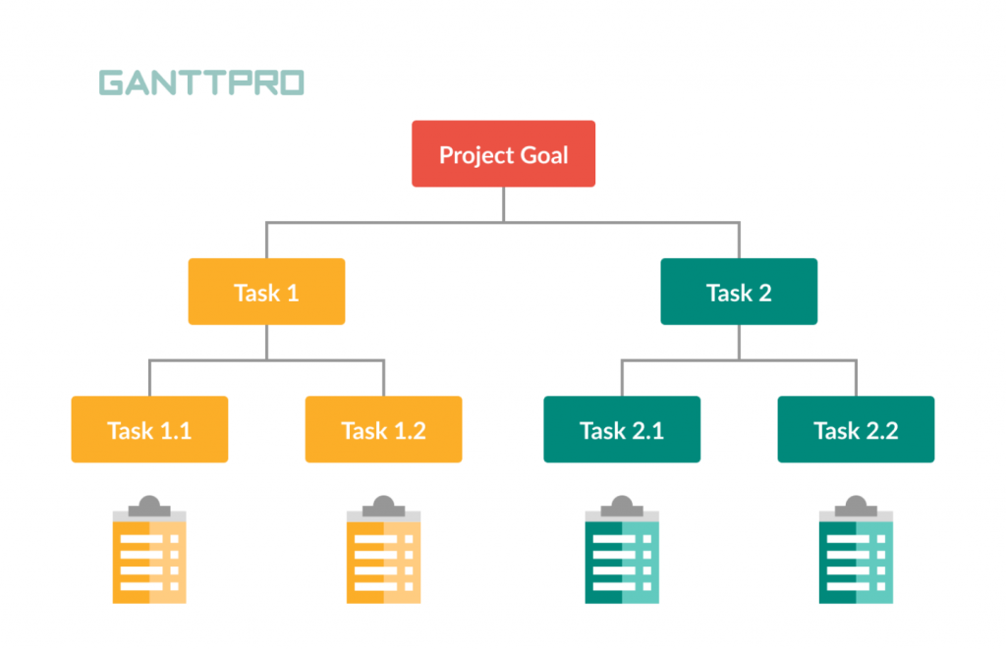

Slide 11
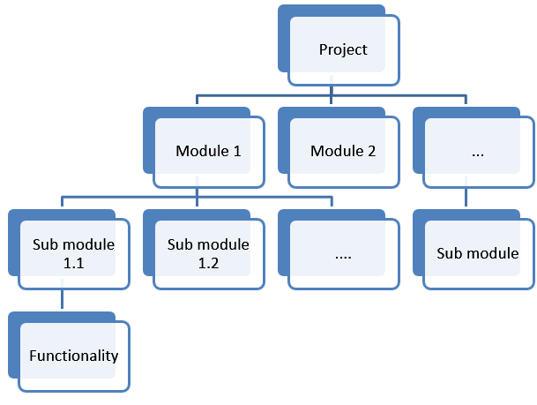

Slide 12
The Work Breakdown Structure
Used as a basis for a number of in particular to produce the subsidiary plans of the Project Management Plan.
The WBS is a deliverable-oriented hierarchy of decomposed project components.
The WBS is a representation of the detailed project scope statement that specifies the work to be accomplished by the project.
The elements comprising the WBS assist the stakeholders in viewing the end product of the project.
The work at the lowest-level WBS component is estimated, scheduled, and tracked.
WBS

Slide 13
When should we develop WBS?
Once the project Scope is agreed (finalized) then before starting the project we need to plan various components (activities) of software development project.

Slide 14
Deliverable-Based Work Breakdown Structure
Phase-Based Work Breakdown Structure

Slide 15
WBS Guidelines
Accurate and readable project organization.
Accurate assignment of responsibilities to the project team.
Indicates the project milestones and control points.
Helps to estimate the cost, time, and risk.
Illustrate the project scope, so the stakeholders can have a better understanding of the same.
15

Slide 16
Guidelines - continued
Include three types of project work
Product
Specifically assigned to a physical product as a unique deliverable
This subset is sometimes referred to as the product breakdown structure
Integration
When products are brought together as a unit
Can be at any level
Support
Level of Effort, Administration, Expenses, Improvement Practices, Contractor Management

Slide 17
Steps to build a WBS
Begin with the Charter, focusing on Objectives and Deliverables
Break the main product(s) down into sub-products
Set the structure to match how you’ll manage the project
Lowest level not too detailed, not too large
Is there a need for Integration?
Identify support activities
Check for completeness - is all the effort included?
Develop a coding structure if needed
Assign work package managers
17

Slide 18
Construction of a WBS
Identifying the main deliverables of a project is the starting point for deriving a work breakdown structure.
This important step is usually done by the project managers and the subject matter experts (SMEs) involved in the project. Once this step is completed, the subject matter experts start breaking down the high-level tasks into smaller chunks of work.
In the process of breaking down the tasks, one can break them down into different levels of detail. One can detail a high level task into ten sub tasks while another can detail the same high level task into 20 sub tasks.
18

Slide 19
WBS Formats
Work Breakdown Structure Chart
Hierarchical Structure
Tabular WBS Design

Slide 20
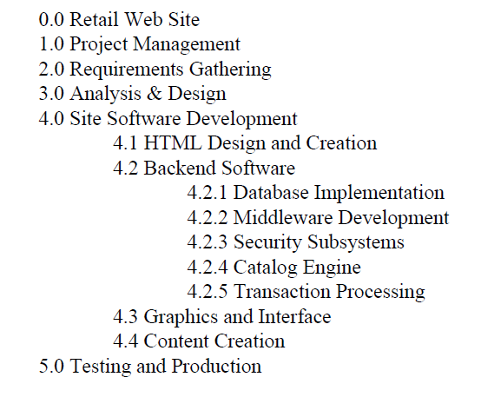
Displaying the WBS Example of outlined WBS.
20

Slide 21
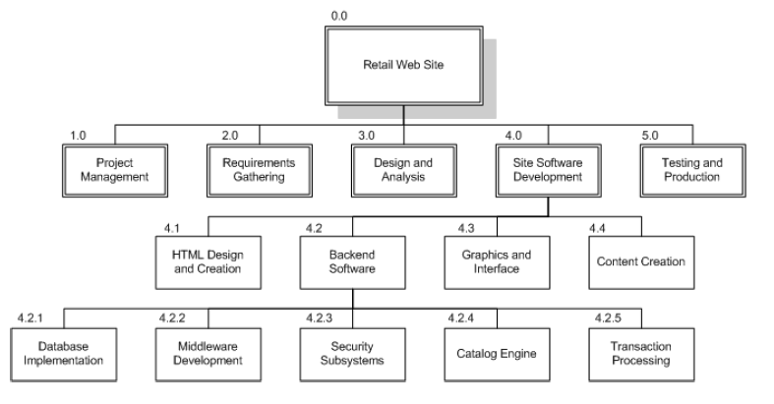
Displaying the WBS Example of Chart WBS.
21

Slide 22
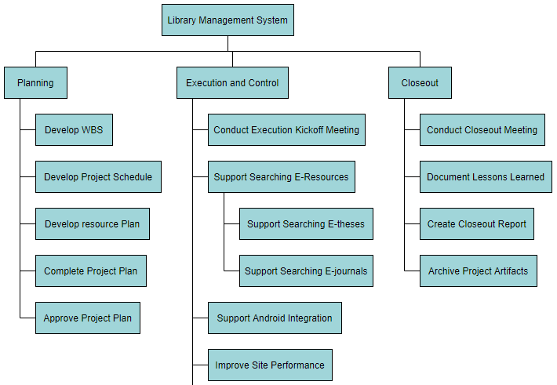
https://online.visual-paradigm.com/diagrams/features/work-breakdown-structure-software/

Slide 23
WBS helps manager
Facilitates evaluation of cost, time, and technical performance of the organization on a project.
Provides management with information appropriate to each organizational level.
Helps organization to project responsibilities to organizational units and individuals
Helps manager plan, schedule, and budget.
Defines communication channels and assists in coordinating the various project elements.
23

Slide 24
Pitfalls
There are common pitfalls to creating a WBS. If you can keep these few possible, you and your team will be much more successful at creating a useful and accurate Work Breakdown Structure.
Level of Work Package Detail
Deliverables Not Activities or Tasks
WBS is not a Plan or Schedule
WBS Updates Require Change Control
WBS is not an Organizational Hierarchy
24

Slide 25
The Dictionary of the WBS
A WBS dictionary is a companion document to the WBS that describes each WBS element. For each WBS element, the WBS dictionary includes a statement of work, a list of associated activities, and a list of milestones.
Other information can include the responsible organisation, start and end dates, resources required.
WBS

Slide 26
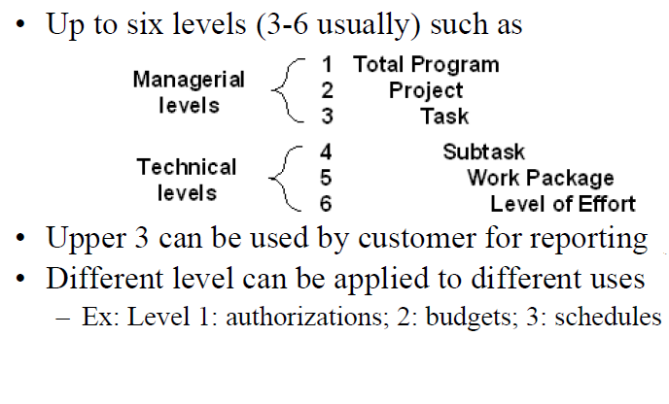
A Full WBS Structure
26

Slide 27
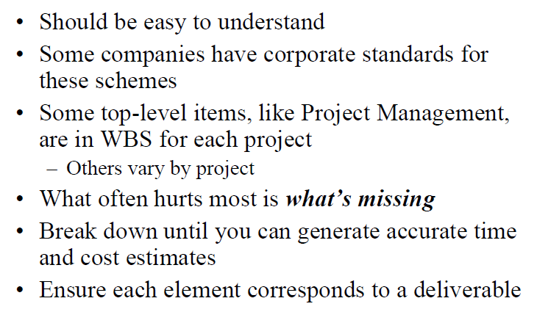
WBS Guidelines
27

Slide 28
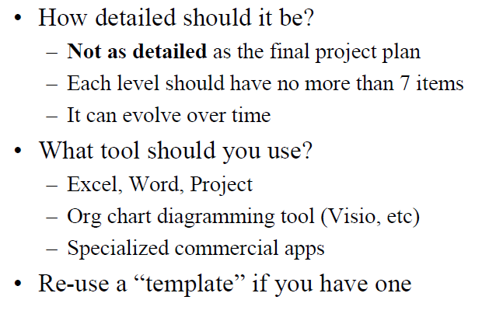
WBS Guidelines
28

Slide 29
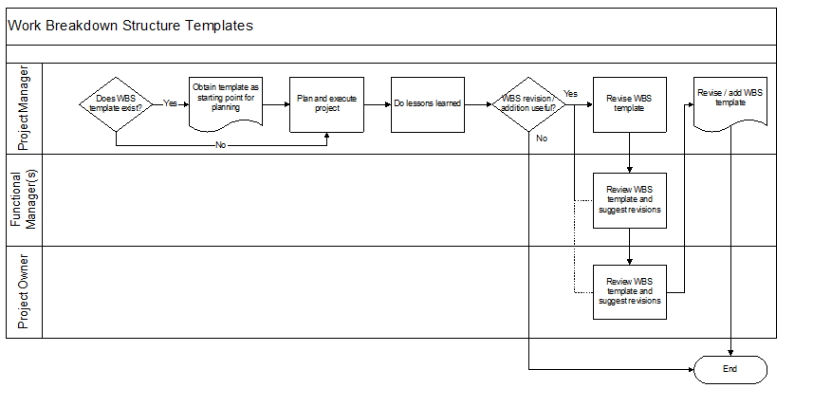
Suggested WBS Template Process

Slide 30
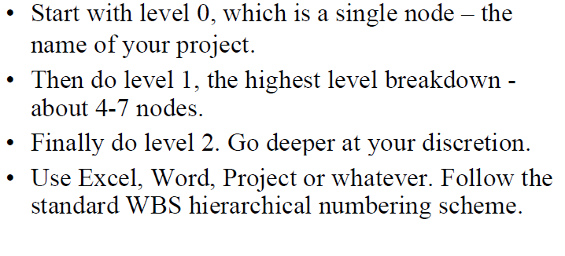
WBS Project Work
30

Slide 31
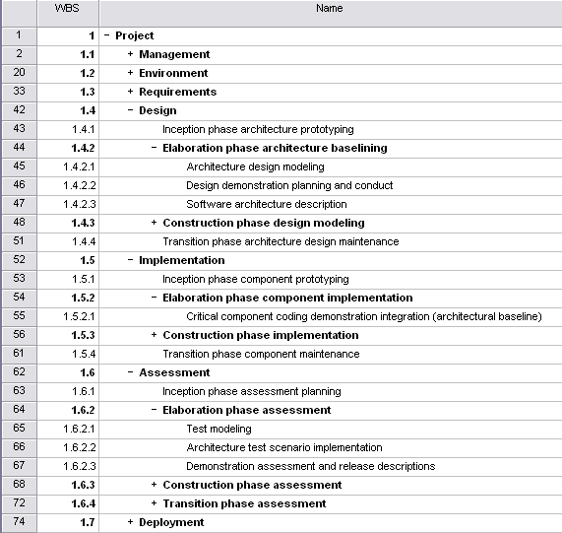
WBS Template
Component groups with a ‘+’ in front of them are ‘rolled up’ – subcomponents are hidden to reduce clutter
31

Slide 32
WBS Check List
Does it define 100% of the work that will be produced by the project?
Does it use a coding structure so that each element has a unique ID that shows its place in the hierarchy e.g. 1.1, 1.2, 1.1.1, 1.1.2?
Will project stakeholders be able to understand the project scope from the WBS?
Does each level represent 100% of the work required to deliver the parent level?
Is the decomposition sufficient that the tasks required to deliver each work package can easily be identified?
Is it in the format that gives a clear graphical, textual or tabular breakdown of the project scope?
32

Slide 33
WBS Check List
Does it have a least two levels with at least one level of decomposition?
Was it created by those who will be performing the work?
Is it being regularly updated as project changes are approved?
Can you identify one person who is accountable for each work package?
Can you clearly define the acceptance criteria for each work package?
Does it allow you to estimate costs accurately?
Does the WBS have logical summary elements that can be used in tracking progress and performance?
33

Slide 34
Example WBS
Redecorate Room
Prepare materials
Buy paint
Buy a ladder
Buy brushes/rollers
Buy wallpaper remover
Prepare room
Remove old wallpaper
Remove detachable decorations
Cover floor with old newspapers
Cover electrical outlets/switches with tape
Cover furniture with sheets
Paint the room
Clean up the room
Dispose or store left over paint
Clean brushes/rollers
Dispose of old newspapers
Remove covers
WBS

Slide 35
References
https://itpmschool.com/work-breakdown-structure-guide/
https://itsadeliverything.com/got-a-wbs-for-your-agile-project-sure-of-course

Slide 36
That is all
36

